Slide 1
STROKE ANALYSIS USING ML ALGORITHUMS
PRESENTED BY:
A SAI SRI VIDYADHARI

Slide 2
JOURNALS
S.NO | TITLE | JOURNAL | AUTHORS | ALGORITHUMS USED | CONCLUSIONS
1 | A predictive analytics approach for stroke prediction using machine learning and neural networks | Elsevier (Feb-2022) | S. Dev, H. Wang, C.S. Nwosu et al. | DT, RF, NN, CNN, SVM, LASSO, Electric net | Conclude that age, heart disease, average glucose level, and hypertension are the most important factors for stroke analysis. Neural network using these four attributes provides the highest accuracy rate
2 | Analyzing the Performance of Stroke Prediction using ML Classification Algorithms | IJACSA (Nov-2021) | G Sailasya , G L Aruna Kumari et al. | Logistic Regression, DT classification, RF classification, KNN, SVM, Naïve Bayes classification | Naïve Bayes Classification performs best with an accuracy of 82%.
3 | Stroke Disease Detection and Prediction Using Robust Learning Approaches | Hindawi Journal of Healthcare Engineering (Nov-2021) | T Tazin, Md Nur Alam, N N Dola, Md Sajibul Bari et al. | Logistic Regression (LR), DT Classification, RF Classification, and Voting Classifier | Random forest method outperforms other methods for brain stroke forecasting.

Slide 3
Why STROKE Analysis IS Needed ?
Stroke is considered as a critical medical condition that should be treated as soon as possible to avoid further complications.
Building a Machine Learning model can help in the early prediction of stroke and reduce the severe impact of the future.
It would help patients obtain early treatment for strokes and rebuild their lives after the event.
By just providing some basic information, the machine learning architecture may help the general public in determining the likelihood of a stroke occurring in an adult patient.
There are two main types of stroke: Ischemic, due to lack of blood flow, and Hemorrhagic, due to bleeding.
Both cause parts of the brain to stop functioning properly.

Slide 4
ML ANLAYSIS FLOW
FLOW ANALYSIS
1. DATA MINING
2. DATA CLEANING
4. FEATURE ENGINEERING
5. PREDICTIVE MODELING
3.DATA EXPLORATION

Slide 5
PROBLEM STATEMENT
According to the World Health Organization (WHO) stroke is the 2nd leading cause of death globally, responsible for approximately 11% of total deaths.
This dataset is used to predict whether a patient is likely to get stroke based on the input parameters like gender, age, various diseases, smoking status …

Slide 6
METHODOLOGY
Different model are applied on the dataset to predict whether an individual will have a stroke or not based on several features.
The dataset is trained on various Machine Learning algorithms and their performance is inspected to find out which one would be the best to efficiently predict stroke.

Slide 7
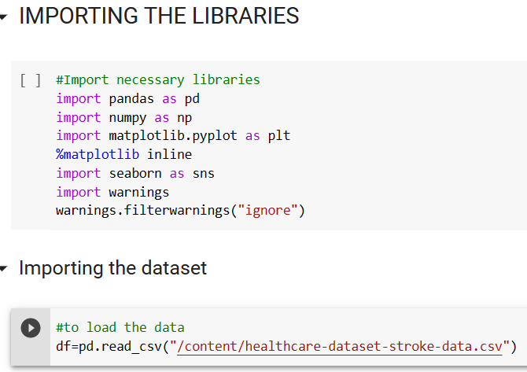
DATA MINING
Data mining is defined as a process used to extract usable data from a larger set of any raw data.
In the practice it is defined as analyzing large databases in order to generate new information.
Data mining has applications in multiple fields, like science and research.

Slide 8
Attribute information
1) id: id of the patient
2) gender: "Male", "Female" or "Other"
3) age: age of the patient
4) hypertension: 0 if the patient doesn't have hypertension, 1 if the patient has hypertension
5) heart_disease: 0 if the patient doesn't have any heart diseases, 1 if the patient has a heart disease
6) ever_married: "No" or "Yes"
7) work_type: "children", "Govt_jov", "Never_worked", "Private" or "Self-employed"
8) Residence_type: "Rural" or "Urban"
9) avg_glucose_level: average glucose level in blood
10) bmi: body mass index
11) smoking_status: "formerly smoked", "never smoked", "smokes" or "Unknown"*
12) stroke: 1 if the patient had a stroke or 0 if not
*Note: "Unknown" in smoking_status means that the information is unavailable for this patient

Slide 9
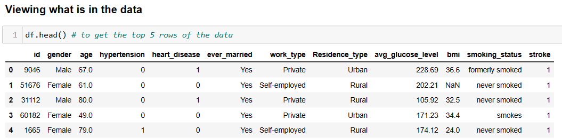
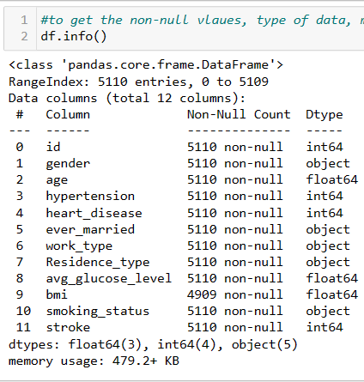
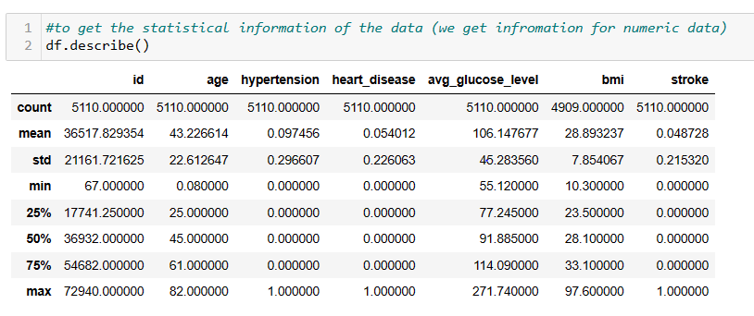
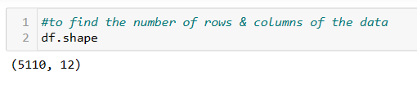
Exploratory data analysis(EDA)
EDA is applied to investigate the data and summarize the key insights.
It will give you the basic understanding of your data, it’s distribution, null values and much more.
You can either explore data using graphs or through some python functions.
In the non-graphical approach, you will be using functions such as shape, summary, describe, isnull, info, datatypes and more.
In the graphical approach, you will be using plots such as scatter, box, bar, density and correlation plots.

Slide 10
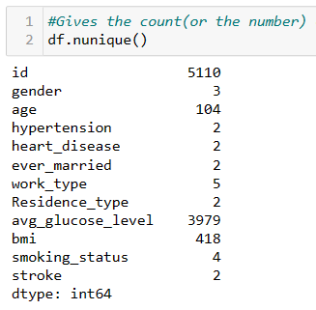
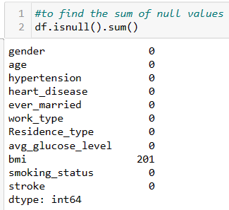

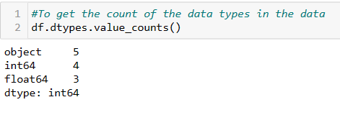
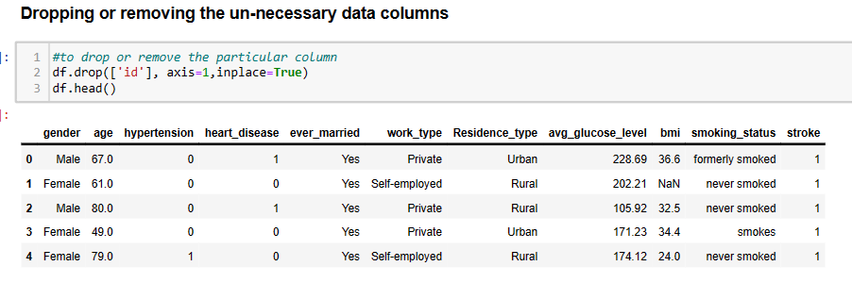
Eda CONTD..

Slide 11
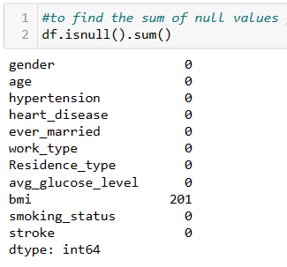
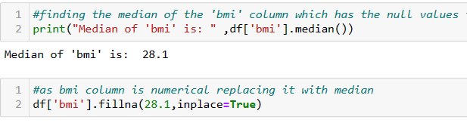
Eda CONTD..
Null values:
A null is neither an empty string (for character or datetime data types) nor a zero value (for numeric data types).
1.continuous variable:--- mean , median
if there are outliers present in the data mean is effected, median is not effected.
2.categorical variable: -- mode

Slide 12
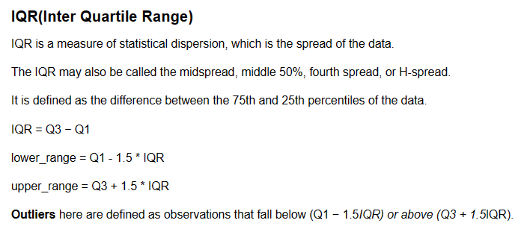
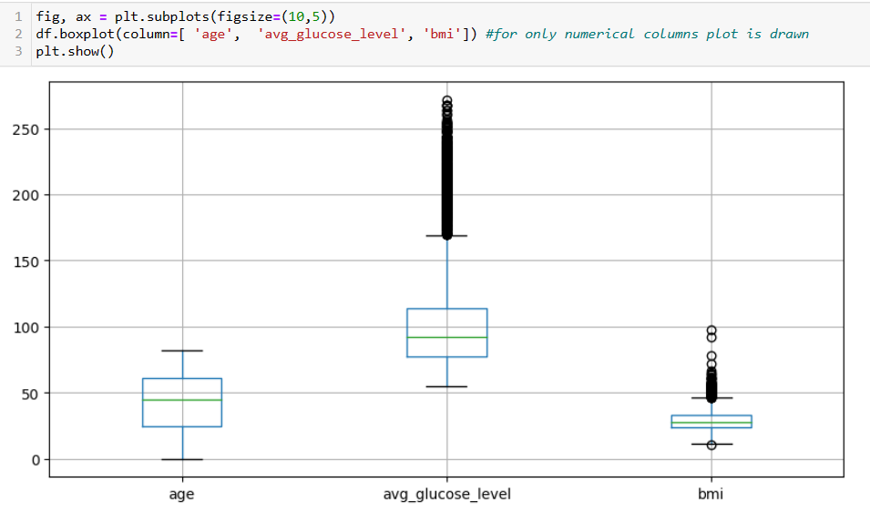
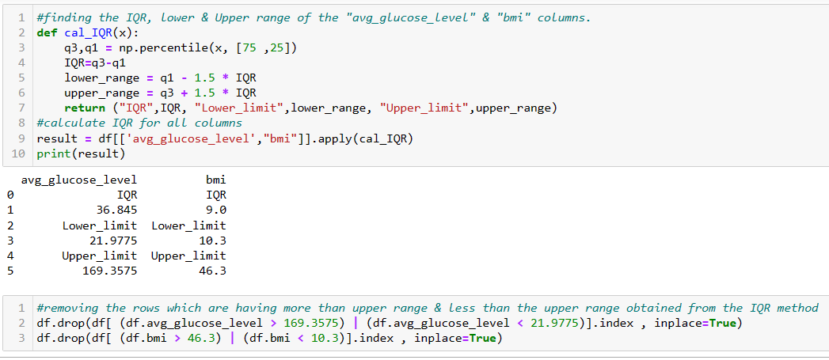
Eda CONTD..
outliers:
Outliers are values within a dataset that vary greatly differ from the others—they're either much larger, or significantly smaller
They can have a big impact on your statistical analyses so they are to be treated before analysis.
There are various methods to treat them but the mostly used is the IQR method.
From the Boxplot we can visualize the outliers

Slide 13
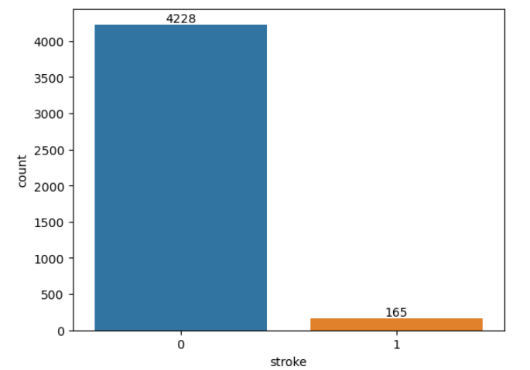
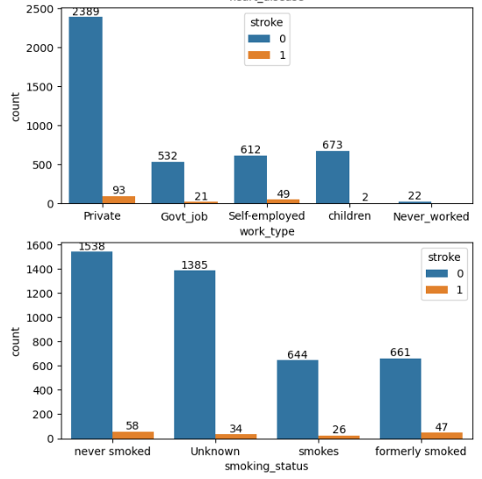
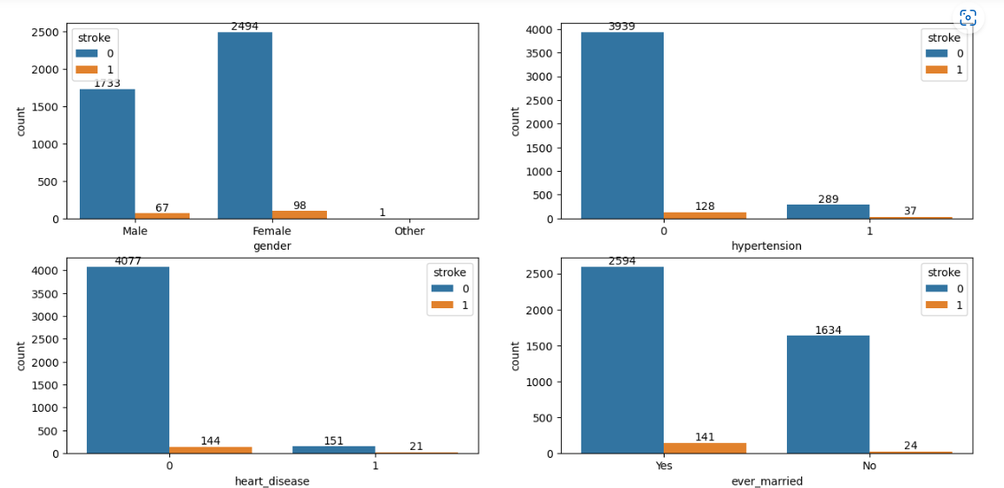
DATA VISUALIZATION

Slide 14
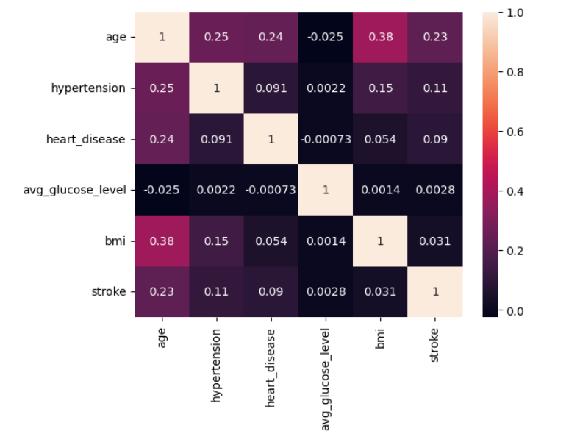
DATA VISUALIZATION
Correlation plot:
A correlation matrix is a table containing correlation coefficients between variables.
Each cell in the table represents the correlation between two variables.
The value lies between -1 and 1.
There are two key components of the correlation are:
Magnitude: larger the magnitude, stronger the correlation.
Sign: if positive, there is a regular correlation. If negative, there is an inverse correlation.
age > hyper_tension > heat_disease > bmi > avg_glucose_level

Slide 15
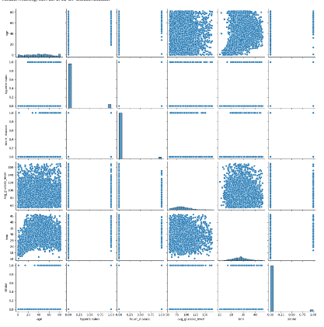
DATA VISUALIZATION
Pair plot:
To plot multiple pairwise bivariate distributions in a dataset, you can use the pairplot() function
The diagonal plots are treated differently: a univariate distribution plot is drawn to show the marginal distribution of the data in each column.

Slide 16
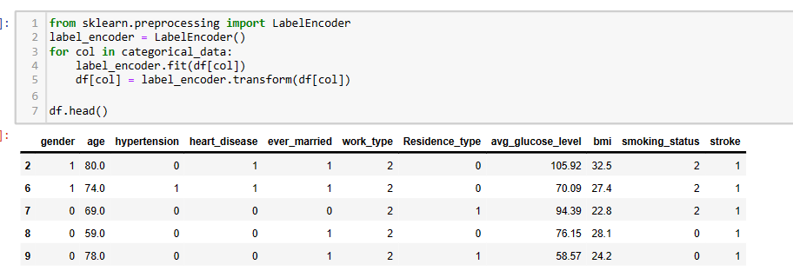
Feature engineering
ENCODING:
To convert categorical columns to numerical columns so that a machine learning algorithm understands it. This process is called categorical encoding.
Two most widely used techniques:
Label Encoding
One-Hot Encoding
Label Encoding is a popular encoding technique for handling categorical variables. In this technique, each label is assigned a unique integer based on alphabetical ordering

Slide 17
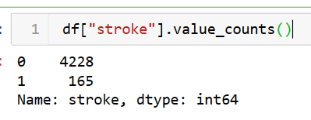
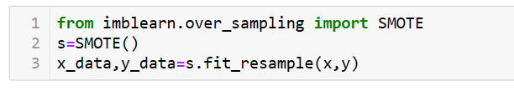
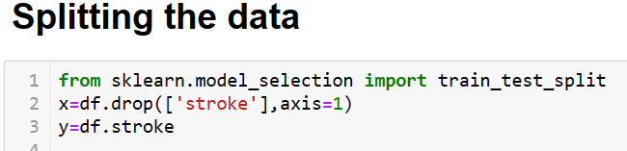
Feature engineering
Balancing the Dataset:
When we are using an imbalanced dataset,
we can oversample the minority class using replacement. This technique is called oversampling.
Similarly, we can randomly delete rows from the majority class to match them with the minority class which is called undersampling.
SMOTE (Synthetic Minority Oversampling Technique):
It is a machine learning technique that is used for the imbalanced data set.
It is a powerful solution for imbalanced data in classification problems.
SMOTE is an algorithm that performs data augmentation by creating synthetic data points based on the original data points.
It is not generating duplicates, but rather creating synthetic data points that are slightly different from the original data points.

Slide 18
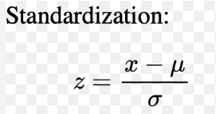
Scaling
Feature Scaling or Standardization:
It is applied to independent variables or features of data which helps to normalize the data within a particular range.
Normalization should be performed when the scale of a feature are misleading
Scaling helps to weigh all the features equally.
It helps in speeding up the calculations in an algorithm.

Slide 19
Model building
Various algorithms are applied on the dataset and check which gives the best prediction.
The various Algorithms applied on this dataset are as follows:
Logistic Regression
Decision Tree Classifier
Random Forest Classifier
K Nearest Neighbour classifier
Support Vector Machine
Naive Bayes

Slide 20
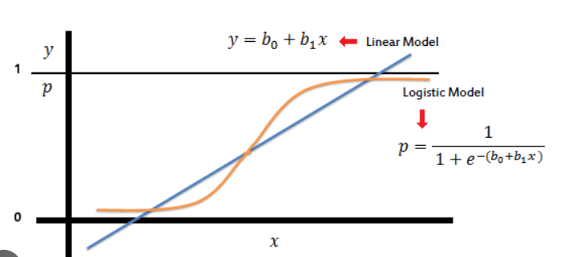
Logistic regression
Logistic regression estimates t he probability of an event occurring based on a given dataset of independent variables.
Since the outcome is a probability, the dependent variable is bounded between 0 and 1.
It is used when the target or dependent variable is categorical.

Slide 21
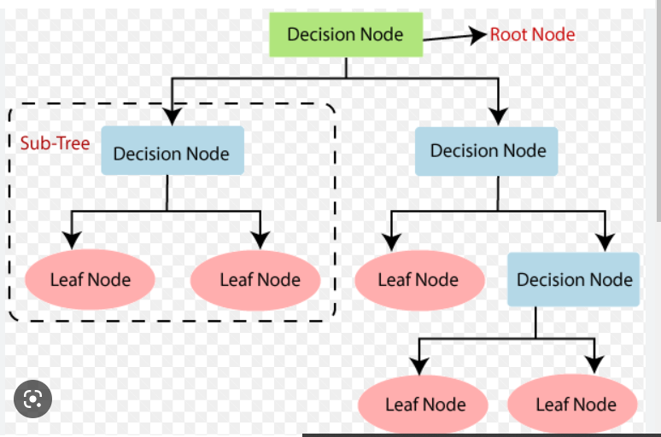
Decision tree classifier
It is called as a ‘Greedy Algorithm’ because it makes the optimal choice at each stage.
It starts from the Root node & branches off to number of solutions.
Root node is present at the beginning of the Decision Tree, from where population is divided according to the factors.
Decision/Internal node is node after the Root node.
Leaf / Terminal node is a node where further split is not possible, Here we have the decision (yes/no).
Sub-tree is the Sub-section of a decision tree.

Slide 22
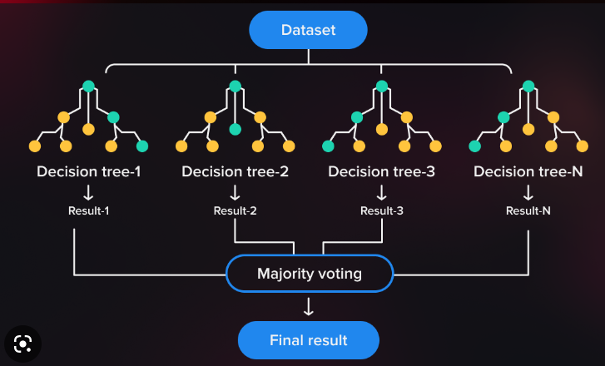
Random forest classifier
Random forest classifier creates a set of decision trees from a randomly selected subset of the training set.
It collects the votes from different decision trees to decide the final prediction.

Slide 23
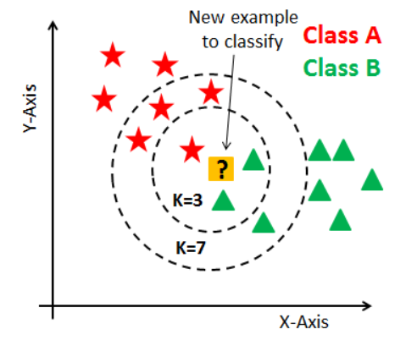
K-nearest neighbour classifier
KNN it uses the entire dataset as a training set.
It is called as a ‘Lazy Algorithm’ because it learns during the testing phase.
Value of ‘k’ is user defined.
If k=1 then leads to ‘over fitting’- it perform good in training phase & bad in testing phase.
If k=high then leads to ‘under fitting’ – it perform poor in both training & testing phase.
Choose k value as odd to break the tie in Binary class.
K-value is chosen from the ‘Elbow curve (k-value v/s error)’ where there is a sudden drop in error rate.

Slide 24
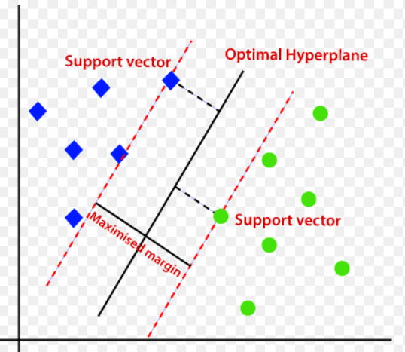
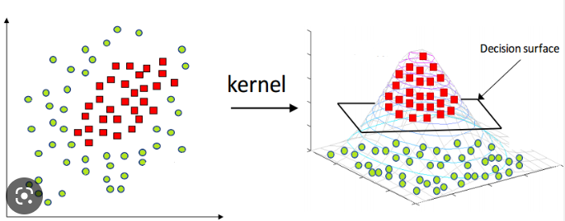
Support vector machine
Each data items are plot in n-dimensional space (n :- no. of features).
it is mostly used in classification problems.
SVM classifier is a frontier that best segregates two classes by Hyperplane / line.
SVM algorithm has a technique called the kernel trick.
It has a function that takes low dimensional input space and transforms it to a higher dimensional space (i.e. it converts not separable problem to separable problem. It is mostly useful in non-linear separation problem).

Slide 25
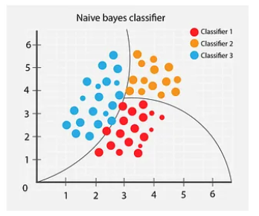
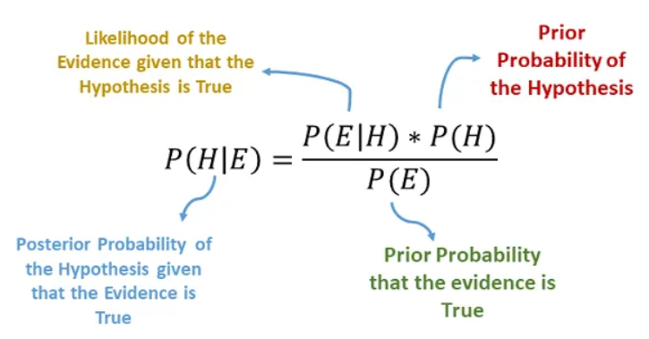
Naive Bayes
Naive Bayes classifier assumes that the features we use to predict the target are independent and do not affect each other (but in general there will be a effect).
The word naive means lack of experience.
It will calculate the probability of an event will occur given another event has already occurred.
Bayes Therom is used to find the probability of the hypothesis with the given evidence

Slide 26
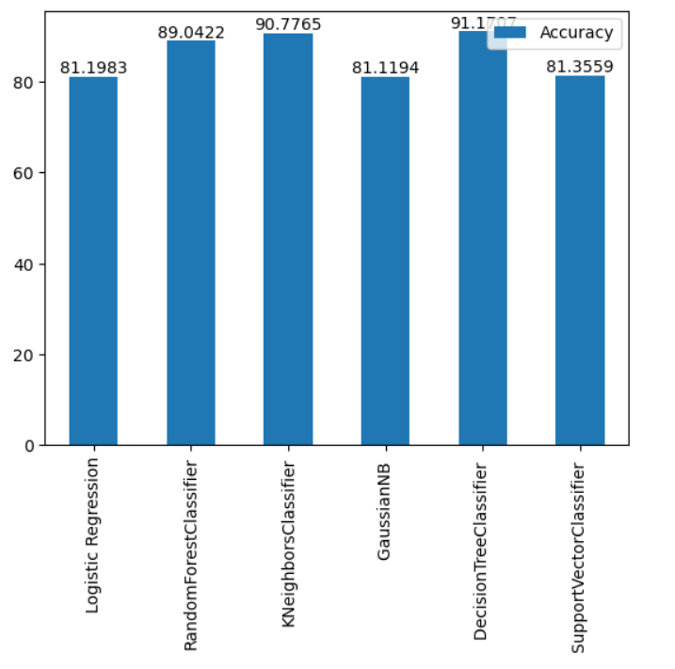
Model Evaluation
From this plot we can see the accuracy of various algorithms that has applied on this data.
We can conclude that the Decision Tree Classifier is giving the higher accuracy compared to the other algorithms.

Slide 27
Future scope
Machine learning applications are becoming more widely used in the health care sector.
The prediction of stroke using machine learning algorithms has been studied extensively.
Building a prediction model that can predict the risk of stroke from lab test data could save lives.
In future studies, we aim to use data that provide information about different types of stroke to build prediction models for each type.
Applying other algorithms and doing the advanced analysis.

Slide 28
THANKYOU

